Slide 1

DC Motors (transistors & diodes)
Pete Januarius – June 2019

Slide 2
Goals
Success Criteria
Understand how a DC Motor works
Understand how a basic transistor works
Build a circuit that spins a DC Motor
Add a button to allow the motor to spin only when pressed
Build a working circuit to spin a DC Motor
Understand how a DC Motor, transistor and a diode work

Slide 3
What is a DC Motor?
A DC Motor converts electrical energy into mechanical energy
A DC motor consists of an stator, an armature, a rotor and a commutator with brushes. Opposite polarity between the two magnetic fields inside the motor cause it to turn.

Slide 4
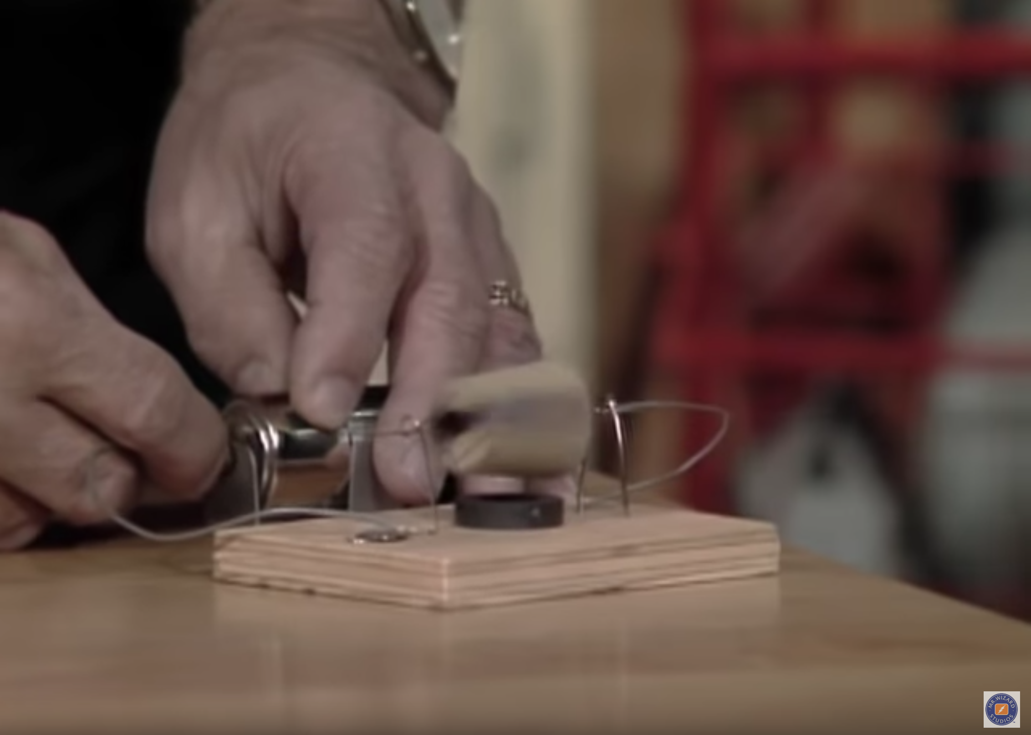
Watch... How DC Motors Work
https://youtu.be/NvQSEU0CDSo

Slide 5
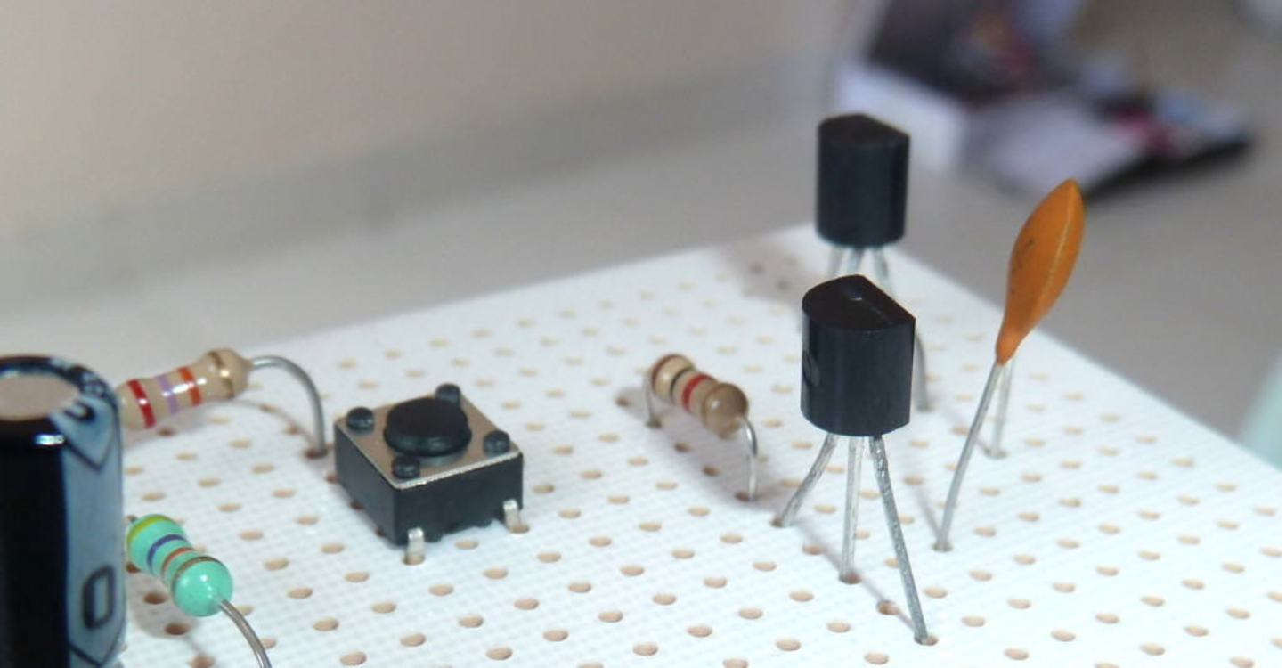
Transistors
The transistor is like an electronic switch. It can turn a current on and off. A simple way you can think of it is to look at the transistor as switch without any moving parts.
A transistor is similar to a switch in the sense that you can use it to turn something ON and OFF.

Slide 6
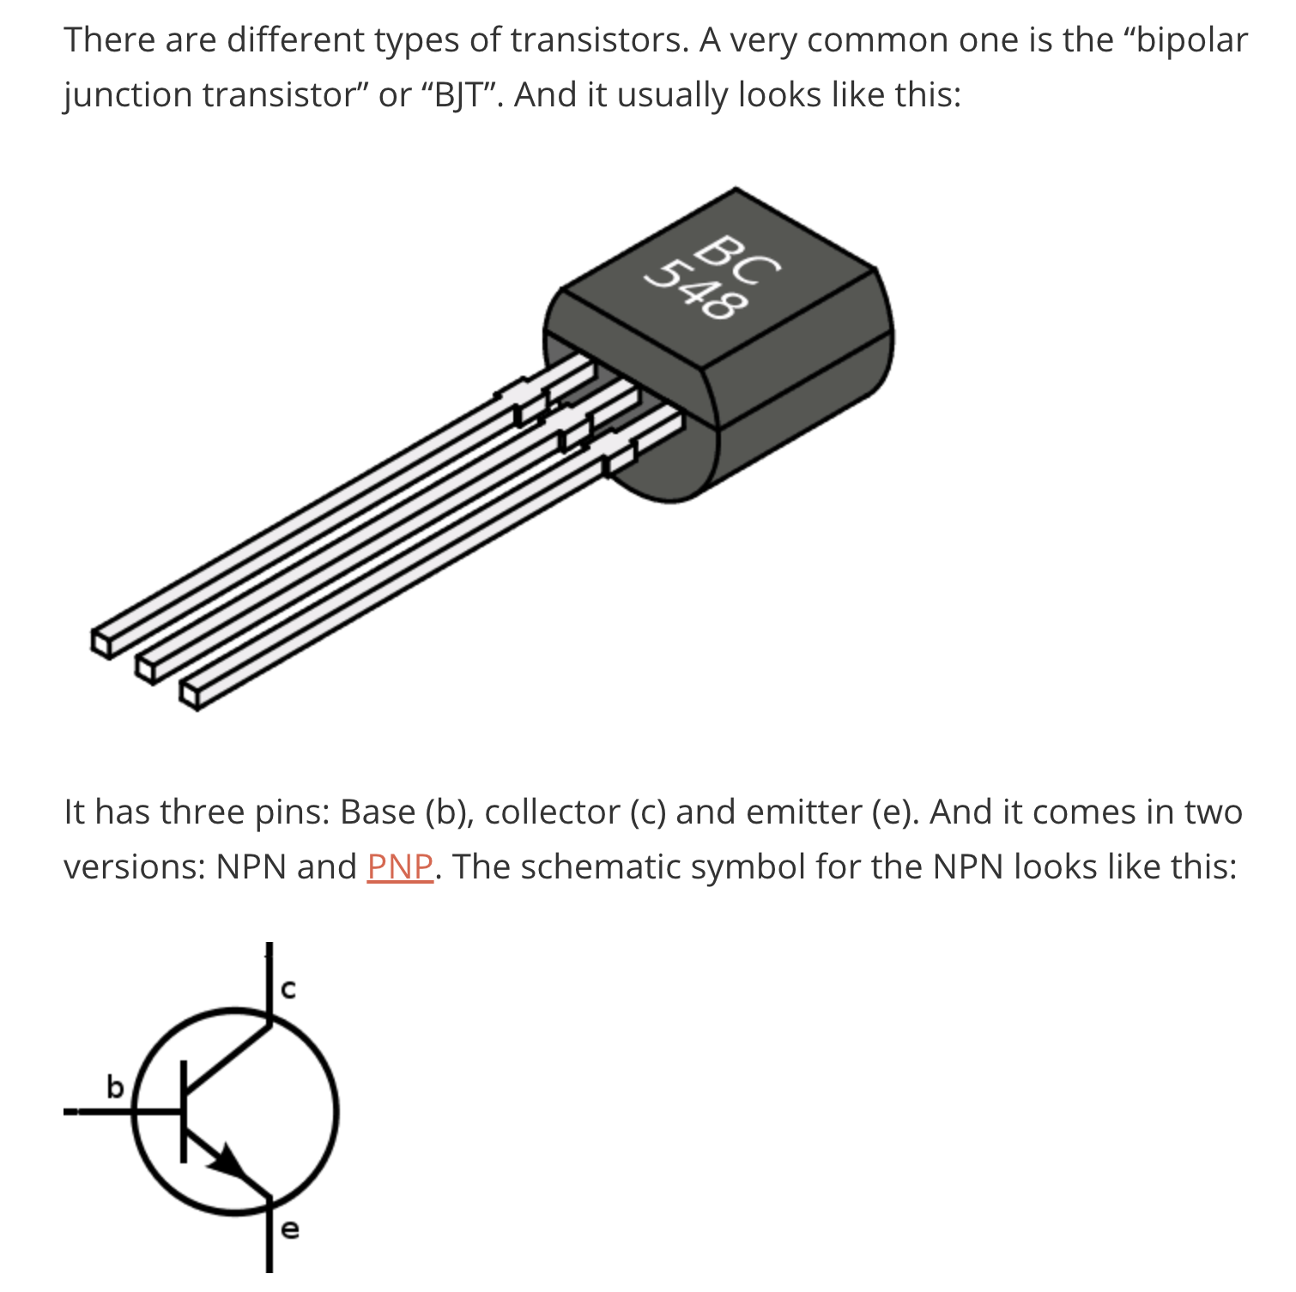

Slide 7
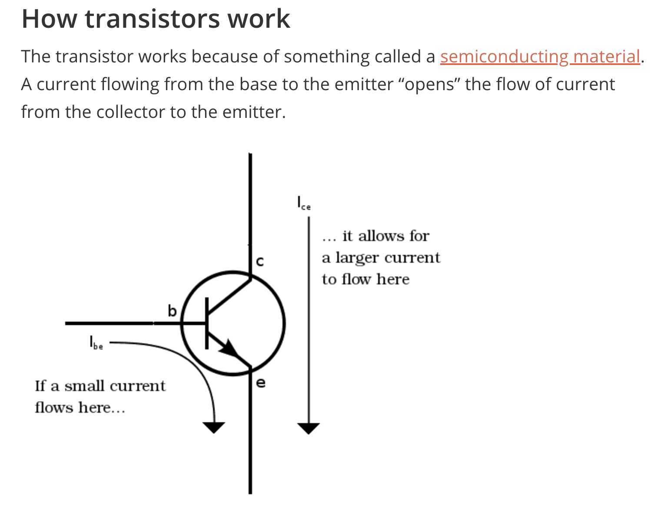
A semi-conductor is a material that conducts current, but only partly.
The conductivity of a semiconductor is somewhere between that of an insulator, which has almost no conductivity, and a conductor which has almost full conductivity.

Slide 8
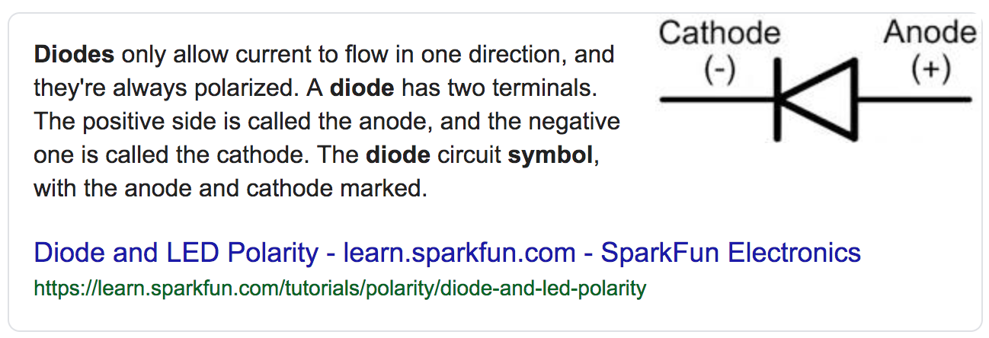
Diodes

Slide 9
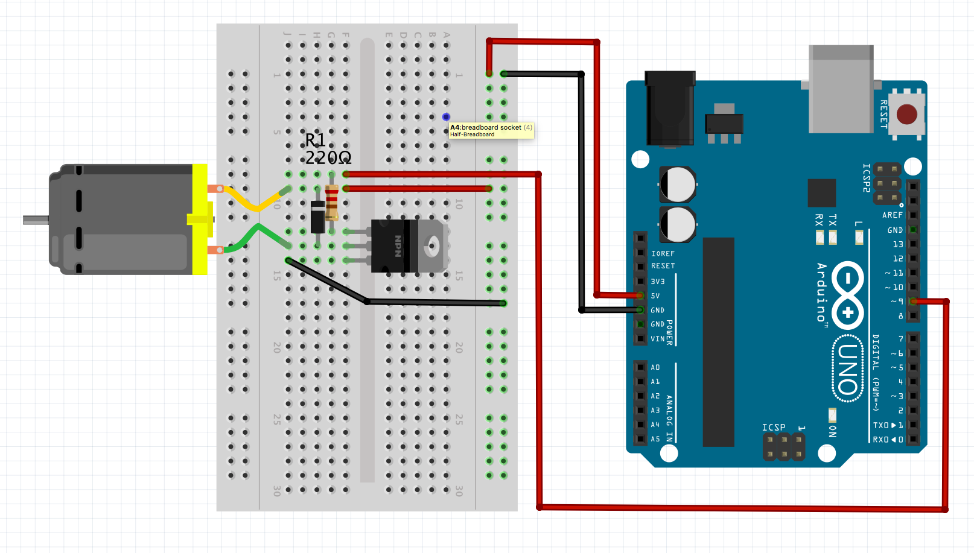
Activity: Build a DC Motor Circuit

Slide 10
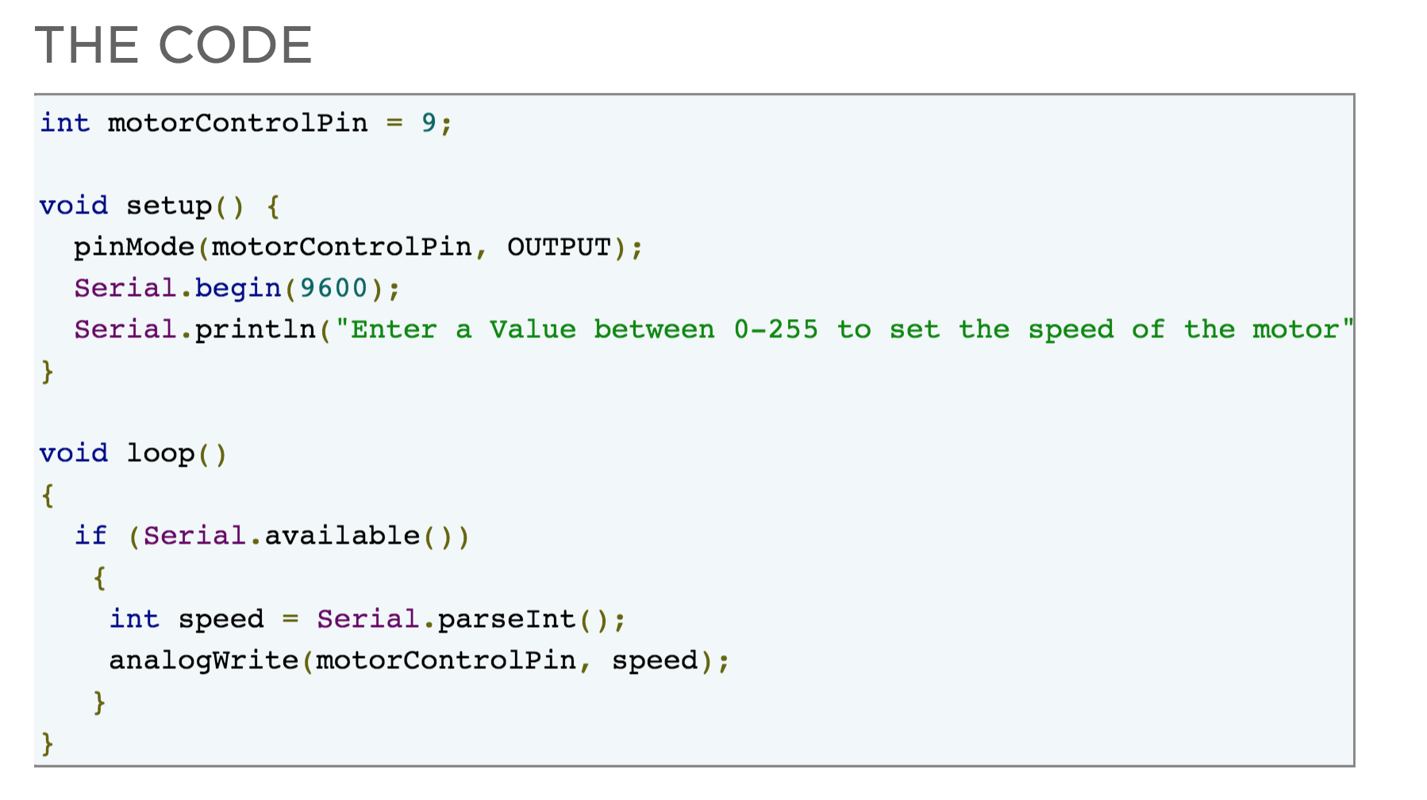
Activity: Code the Circuit

Slide 11
Challenge: Make a control button
With the knowledge you have gained, can you add a pushbutton, into the circuit so that the motor will ONLY work if the button is pushed?
HINT: You will need a push button, a >=1000 Ohm resistor (or close to that) and a couple of M-M jumpers wires. You should be able to connect all these on the breadboard to make it work.

Slide 12
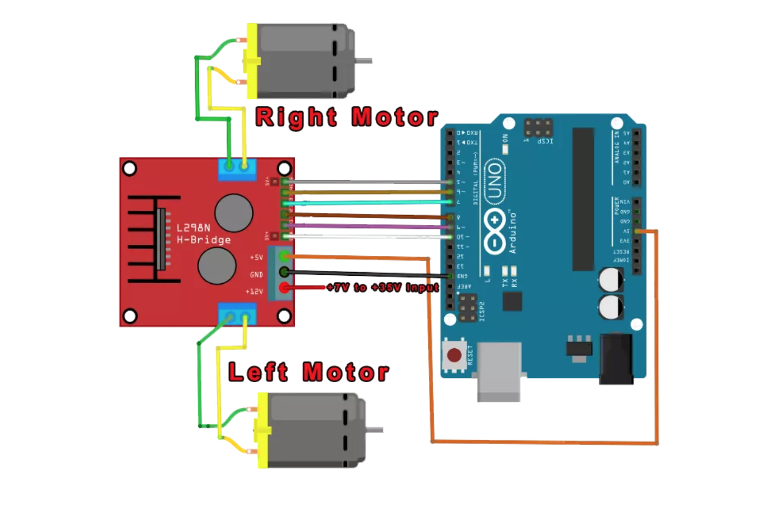
Activity: Build a DC Motor Circuit 2
These connections can go any way round. Reversing them will reverse the direction
Only plug the 5v jumper
in when you have completed
the circuit and checked it and have uploaded the code. This will then start the motors.
Make sure there are no jumpers in these pins
The 9v battery –ve terminal must be plugged in here to GND
Use a 9v Battery
for the Power Supply. This will power up the L298N. The 5v pin to the Arduino will power the Arduino so you can unplug the Arduino from your computer after uploading the sketch

Slide 13
The L298N Motor Driver

Slide 14
The L298N H-Bridge Configuration
(or... how it works!)
The L298N motor controller follows the H-bridge configuration, which is handy when controlling the direction of rotation of a DC motor. An H-bridge schematic looks like this:
Here, the motor rotates in the direction dictated by the switches. When S1 and S4 are on, the left motor terminal is more positive than the right terminal, and the motor rotates in a certain direction. On the other hand, when S2 and S3 are on, the right motor terminal is more positive than the left motor terminal, making the motor rotate in the other direction.
The other benefit of using an H-bridge is that you can provide a separate power supply to the motors. This is very significant especially when using an Arduino board where the 5V power source is simply not enough for two DC motors.

Slide 15
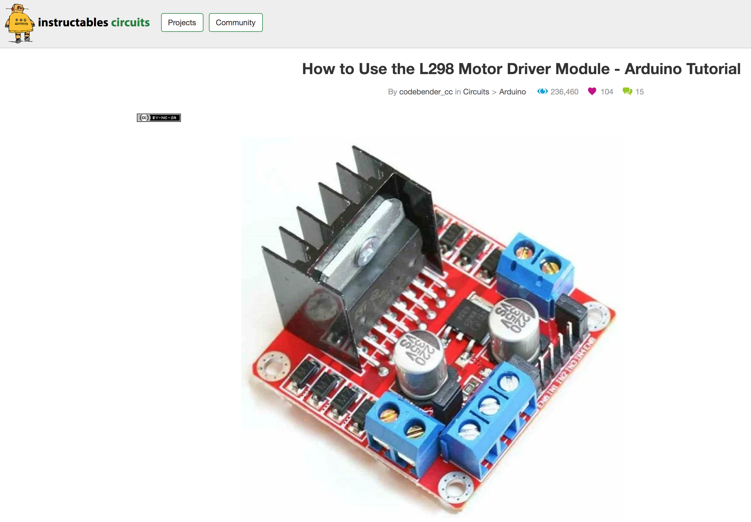
Read: How to use an L298N Motor Driver
https://www.instructables.com/id/How-to-use-the-L298-Motor-Driver-Module-Arduino-Tu/

Slide 16

Concept: What is PWM (Pulse Width Modulation)?
https://youtu.be/ISzRh5eN_Pg
Watch to 2:50

Slide 17
PWM in Motors
Speed control is also possible with the L298N motor driver. All you need is feed PWM signals to the motor enable pins. The speed of the motor will vary according to the width of the pulses. The wider the pulses, the faster the motor rotates. How fast the motor rotates for a given pulse width will vary from motor to motor even if they look exactly the same. Thus, the actual pulse width must be derived through experiment.

Slide 18
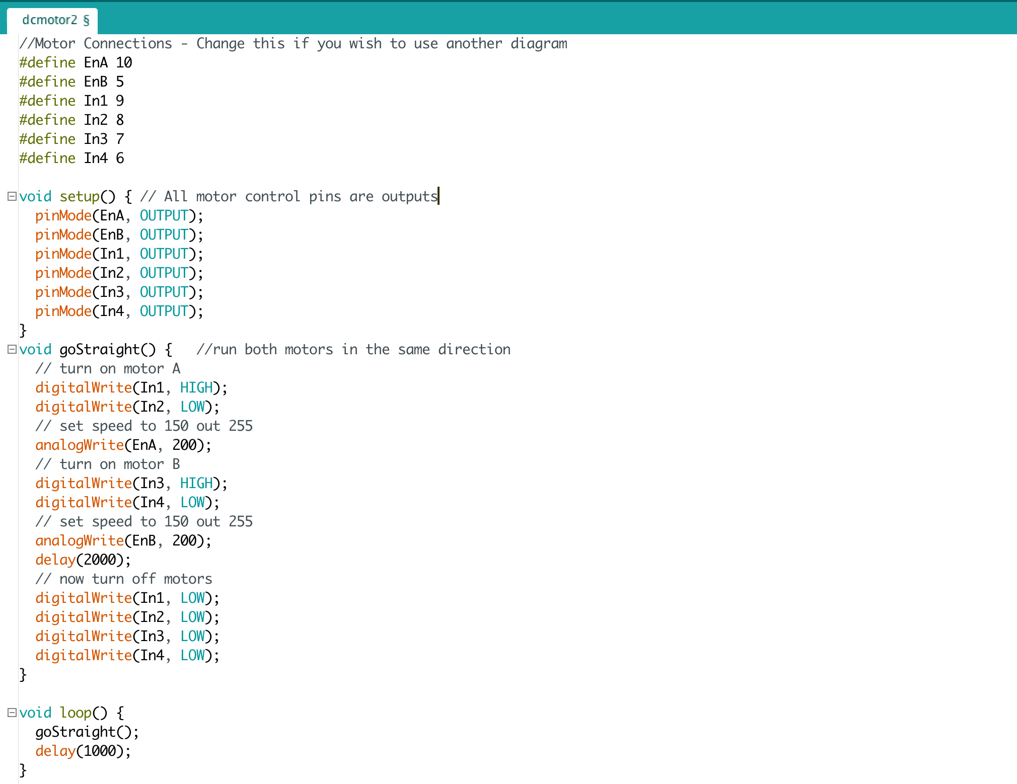
Activity: Code the Circuit

Slide 19
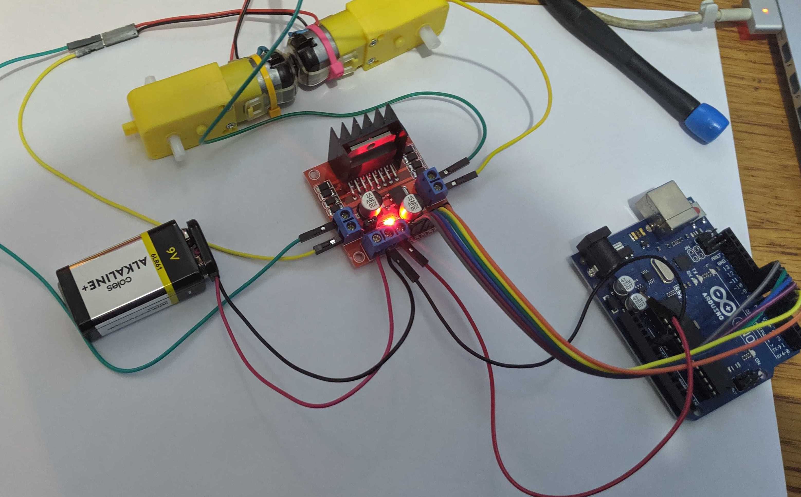
Activity: The Complete Circuit

Slide 20
Homework: Read more....
Read about the L298N and how it works here:
https://www.teachmemicro.com/use-l298n-motor-driver/

Slide 21


